Slide 1
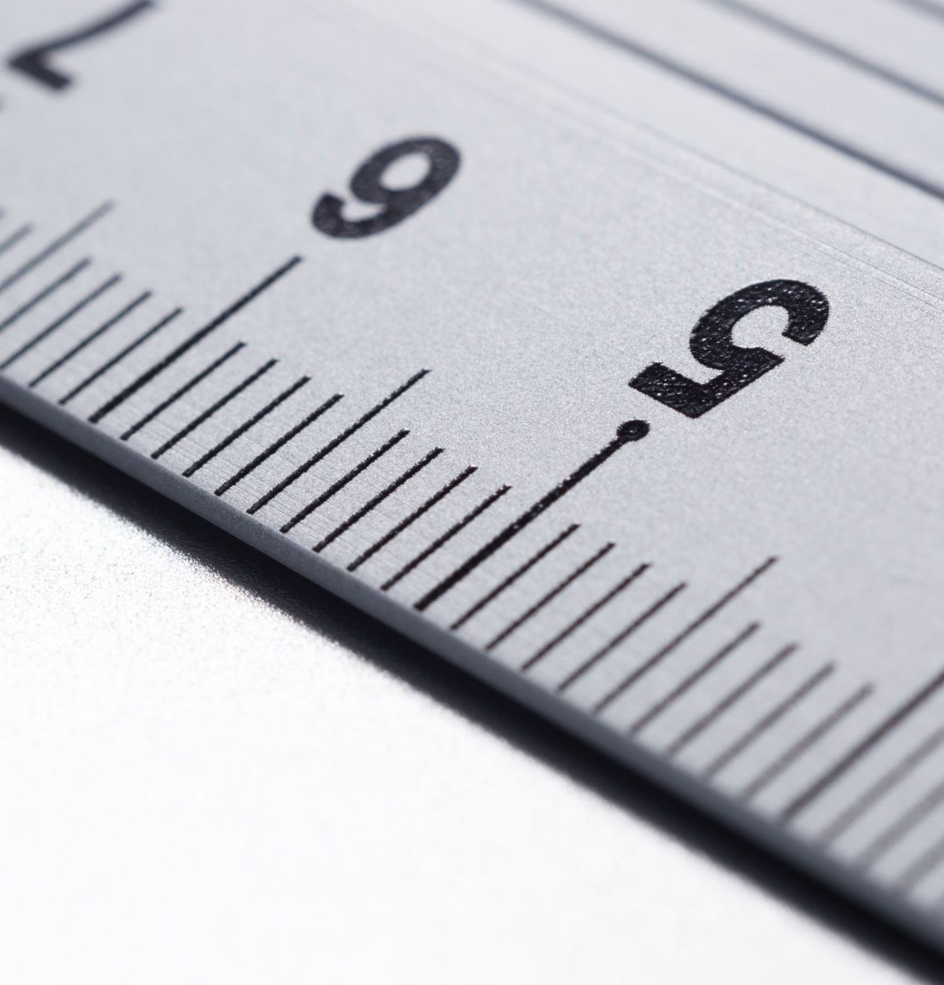
Intro to SVG Part 3: Introducing paths

Slide 2

Rob Larsen
Rob is an experienced front-end engineer, author and open-source contributor.
Rob is co-author of Professional jQuery, the author of Beginning HTML and CSS, the author of The Uncertain Web, from O’Reilly, the author of Mastering SVG and co-author of The HTML and CSS Workshop.
A long-time open-source contributor, Rob currently maintains HTML5-Boilerplate and administers the H5BP organization on GitHub.

Slide 3
What we’ll cover
What the <path> element is and why it's the most important element in SVG.
How to read the commands in the powerful d attribute
Key commands for moving, drawing lines, and creating curves

Slide 4
The <path> element
Notes:
By far the most important element in the SVG specification is the path element.
Path allows you to draw lines and shapes using vectors defined by a series of commands passed
in as an argument to the path element’s d attribute.
One of the biggest roadblocks to early SVG adoption was the lack of a friendly API. Browser support was a bigger issue since you needed the browser to be able to render them, but even with perfect support SVG isn’t the easiest format to work with, using native tools.
The path element is likely the toughest element to work with in the entire specification. You don’t really work with paths directly. It requires tools. The values you might see in a d attribute can be incredibly difficult to read and are complicated.
How difficult to read? How complicated? The next slide will show the code used to render the S from the SVG logo

Slide 5
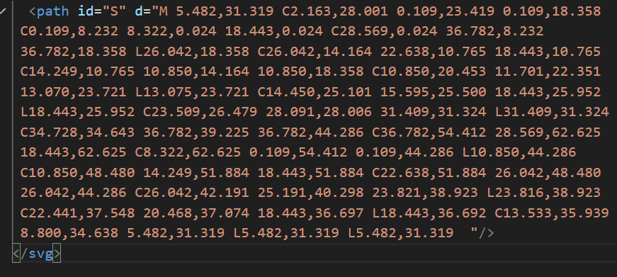
PAth.svg
Notes:
Without knowing what's going on, that's impossible to parse and even knowing the rules
for the d attribute it's difficult to keep track what’s going on here.
There’s a logic there, which is why you can write tools that make SVG magic happen, but a human is going to have hard time keeping track.
Let’s look at a simpler example.

Slide 6
A Path you can Follow!

Slide 7
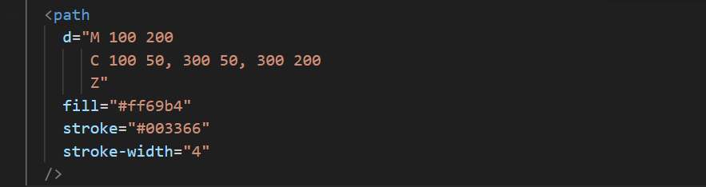
Simple-path.svg
Notes:
Let's look at a simpler example so that you can get your head around the syntax. In this
document, we’re creating a simple half circle. The three instructions are read as follows
Path Breakdown
M 100 200
Move to (100, 200): The path starts at the point (100, 200). This sets the starting position for the drawing.
C 100 50, 300 50, 300 200
Cubic Bézier Curve:
The curve starts at (100, 200).The first control point is at (100, 50).The second control point is at (300, 50).The curve ends at (300, 200).This creates a smooth, arching curve from the left to the right, passing above the starting and ending points.
Z Close Path: Draws a straight line from the current point (300, 200) back to the starting point (100, 200), closing the shape.

Slide 8
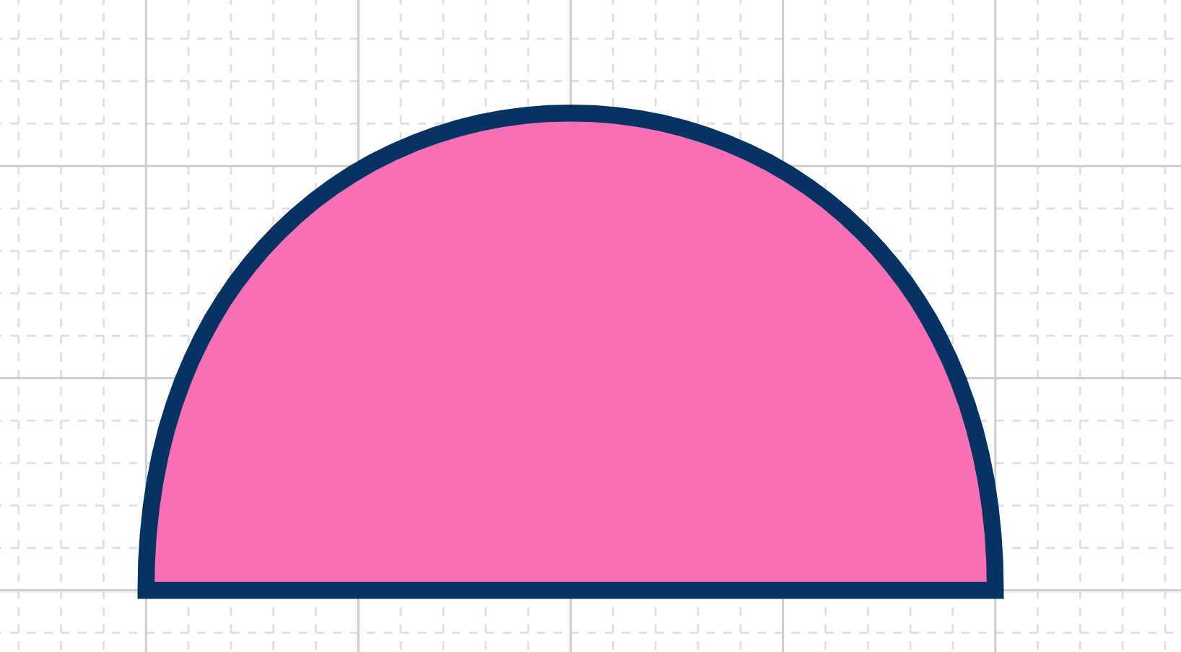
Simple-path.svg
Notes:
This is what the previous instructions draw

Slide 9
Bezier curves?

Slide 10
Bezier curves
In SVG, a Bézier curve is a smooth, curved line defined by a set of points. These points are not all on the curve itself; some act as "control points" that influence its shape.
Types of Points
There are two main types of points used to define a Bézier curve:
Anchor Points: These are the start and end points of the curve. The curve will always pass directly through these points.
Control Points: These are points that are not on the curve itself. They act like magnets, pulling the curve towards them and defining its shape, direction, and steepness. Think of them as handles you can pull to bend the line.

Slide 11
Bezier curves
How Control Points Work
The position of the control points determines the curve's tangent (the direction of the line as it leaves an anchor point) and its magnitude (how far the curve bends).
The line between an anchor point and its corresponding control point sets the initial direction of the curve.
The distance of the control point from the anchor point determines how much the curve bends. A control point further away creates a more pronounced, steeper curve.

Slide 12
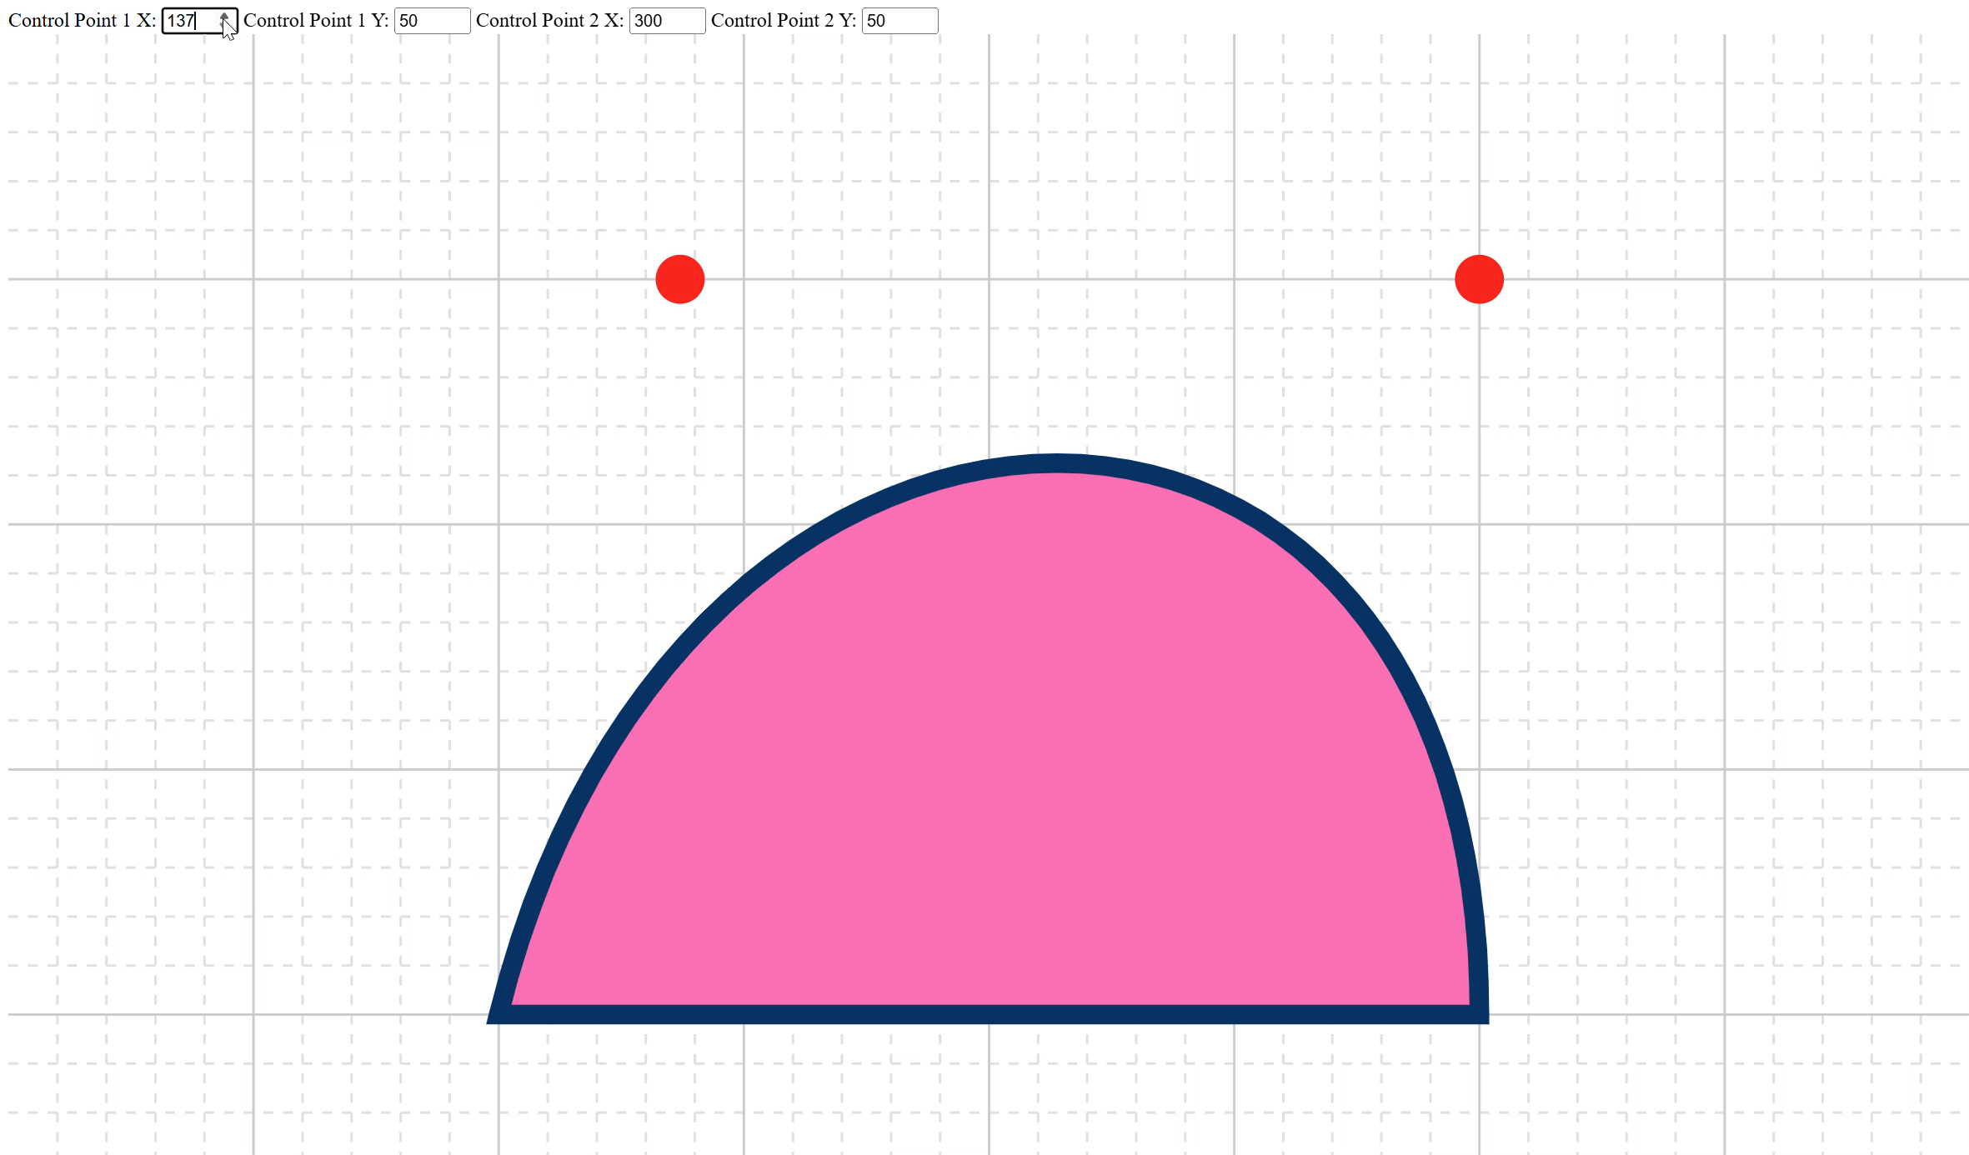
Control points
Notes:
Theres a demo *link in the description” which will allow you to play with control points to get some sense of how they work. If you’ve done work in a vector graphics program like Illustrator this will be more familiar to you and the way the control points map to the shape of the curve might make more sense. If not, this demo will help you see the relationship.

Slide 13
The path API
Notes:
While the audience for this series is by definition people getting started with SVG and therefore unlikely to be people jumping right in and scripting complex path elements, I would be failing in my job as an educator if I don’t at least define what you can do in a path element. I WILL return to the PATH element later on in the series, when we’re beyond the true introductory topics, but for now this brief overview is likely all that you will need. For most of us, awareness of what tools like D3 are doing under the hood are enough.

Slide 14
Command instructions
A key concept to remember is that each command comes in two forms:
Uppercase (e.g., L): Uses absolute coordinates, meaning the points are positioned relative to the SVG canvas's origin (0, 0).
Lowercase (e.g., l): Uses relative coordinates, meaning the points are positioned relative to the previous point in the path.

Slide 15
Command instructions - MOVETO
This command moves the "pen" to a new location without drawing a line. It's used to start a new subpath.
M (Absolute): Move to the coordinate (x, y).
m (Relative): Move by dx horizontally and dy vertically from the current position.

Slide 16
Command instructions - LINETO
These commands draw straight lines from the current position to a new position.
L(ineTo)
L (Absolute): Draw a line to the coordinate (x, y).
l (Relative): Draw a line from the current point to a point dx and dy away.
H(orizontal Lineto)
H (Absolute): Draw a horizontal line to the x-coordinate x.
h (Relative): Draw a horizontal line dx long.
V(ertical Lineto)
V (Absolute): Draw a vertical line to the y-coordinate y.
v (Relative): Draw a vertical line dy long.

Slide 17
Command instructions - CurveTo
Curveto (Bézier Curves)
These commands draw various types of Bézier curves.
C (Cubic Bézier)
Draws a curve to (x, y) using (x1, y1) as the control point for the start of the curve and (x2, y2) as the control point for the end.
S (Smooth Cubic Bézier)
A shortcut for stringing cubic curves together. It assumes the first control point is a reflection of the last control point used in the previous C or S command. (x2, y2) is the second control point, and (x, y) is the end point.
Q (Quadratic Bézier)
Draws a simpler curve to (x, y) using only one control point at (x1, y1).
T (Smooth Quadratic Bézier)
A shortcut for stringing quadratic curves together. It assumes the control point is a reflection of the control point from the previous Q or T command.

Slide 18
Reflected Control Points

Slide 19
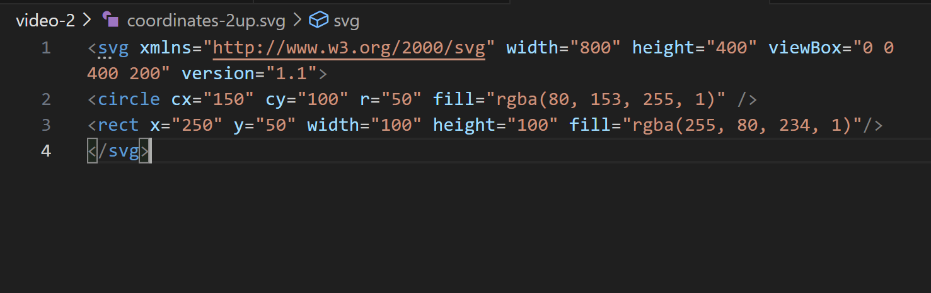
Coordinates-2up.svg
Notes:
To start to understand the way all this works, let’s ask-
What happens if you double the size of the viewport by doubling the height and width of the SVG element- changing nothing else?

Slide 20
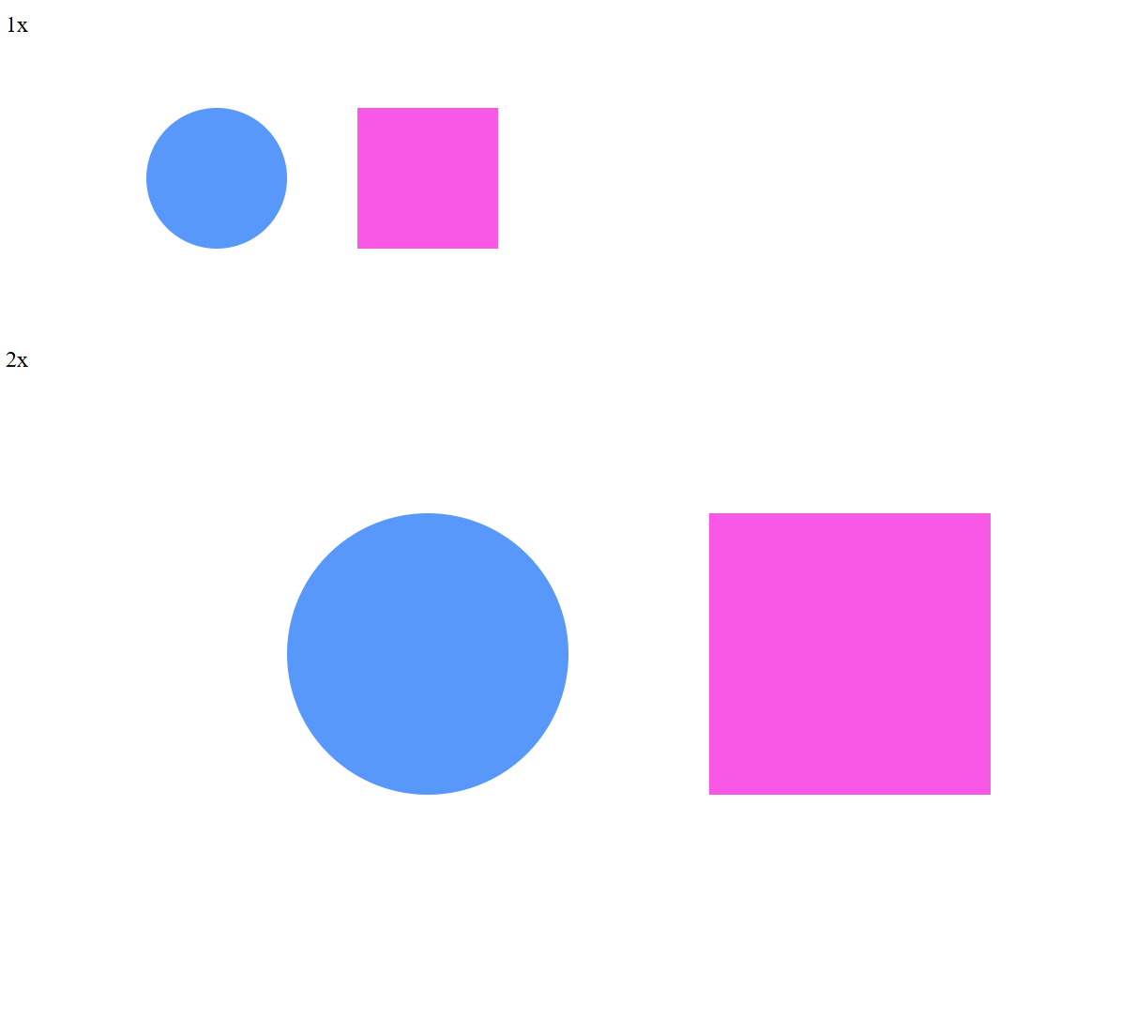
1x and 2x viewport examples
Changing nothing but the height and width scales the image. User units are no longer equivalent to 1 physical pixel, but the calculations are handled automatically by the browser.
Notes:
If you double the height and width, it doubles in viewport size to 800 x 400 pixels and the image scales accordingly. Since the viewBox and all the underlying coordinates remain the same the image scales up perfectly.
Remember, since the rendering of SVG elements happens in the browser and is calculated based on the instructions in your SVG document and not pre-defined pixles (like a JPG or PNG) this means that you can double the size of an image just by changing the height and width and it will scale up perfectly. This is one of the best things about SVG.

Slide 21
Playing with the ViewBox

Slide 22
Viewbox anatomy

Slide 23
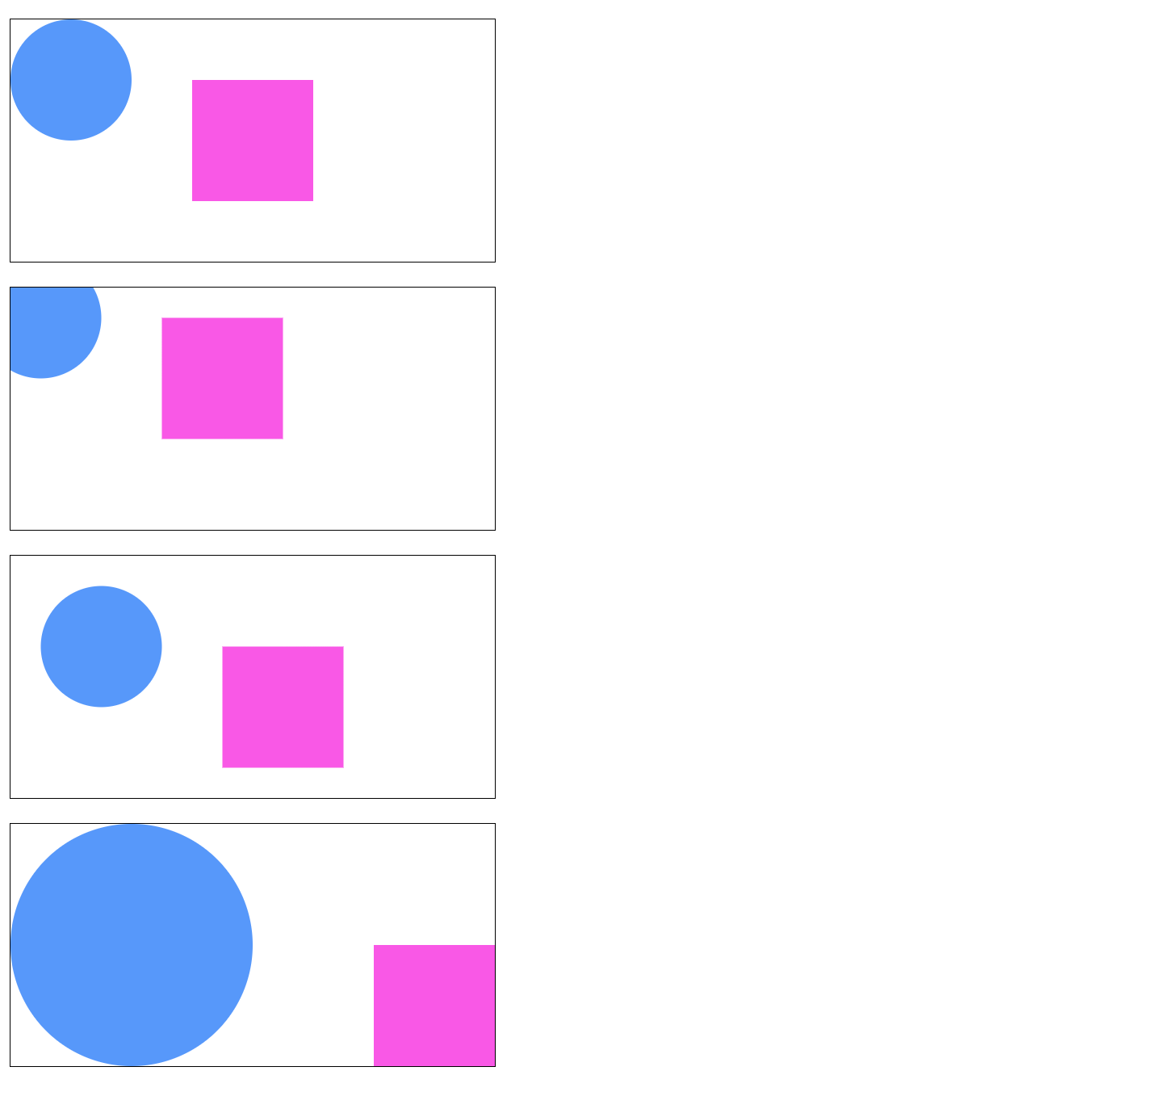
Viewbox-demo-2.html
Notes:
In this example we adjust the viewbox in three different ways.
The first image is the baseline. The origin x and y are set to 0,0 and the height and width match the SVG element’s width (400,200)
The second image offsets the image by negative 25 pixels
The third image offsets the image by a positive 25 pixels
The fourth image sets the origin to 0,0, but changes the viewbox height and width to half of the intrinsic image size (200,100)

Slide 24
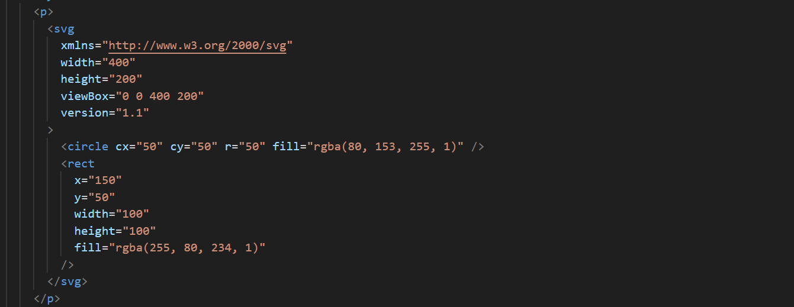
The baseline image
Notes:
This is the baseline the view box is 0 0 400 200.

Slide 25
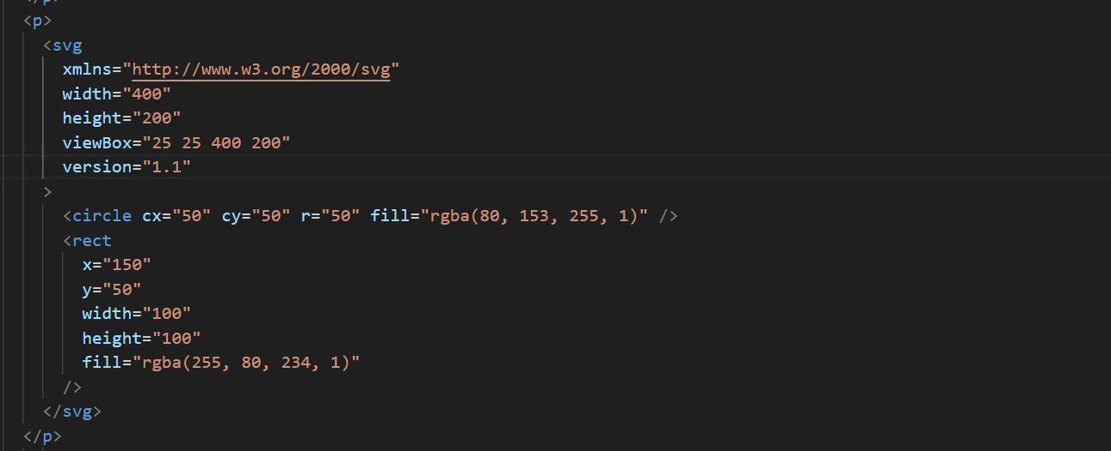
Positive 25 unit offset
Notes:
This pushes the origin up to 25x and 25y while keeping the same viewbox height and width.

Slide 26
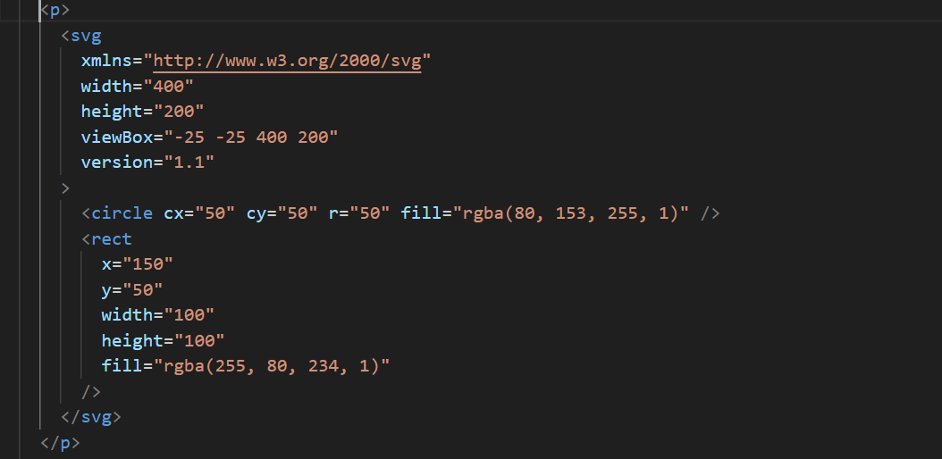
Negative 25 unit offset
Notes:
This pushes the origin back to -25x and -25y while keeping the same viewbox height and width.

Slide 27
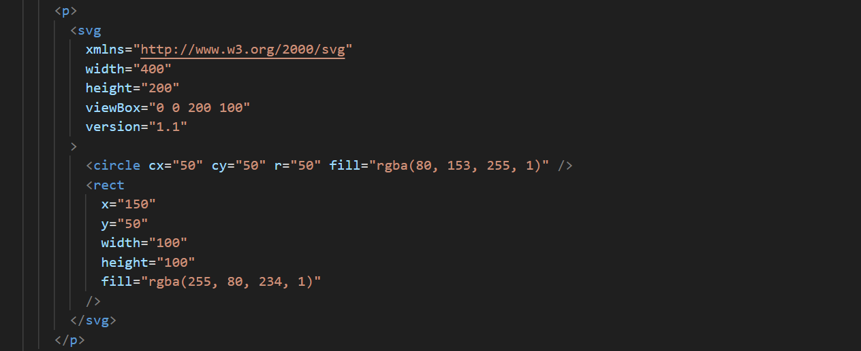
50% ViewBox height and width
Notes:
This shrinks the viewbox width by 50%

Slide 28
Viewbox-demo-2.html
Notes:
This illustrates how the changes we’ve seen change the SVG document. Remember both shapes are defined exactly the same way.

Slide 29
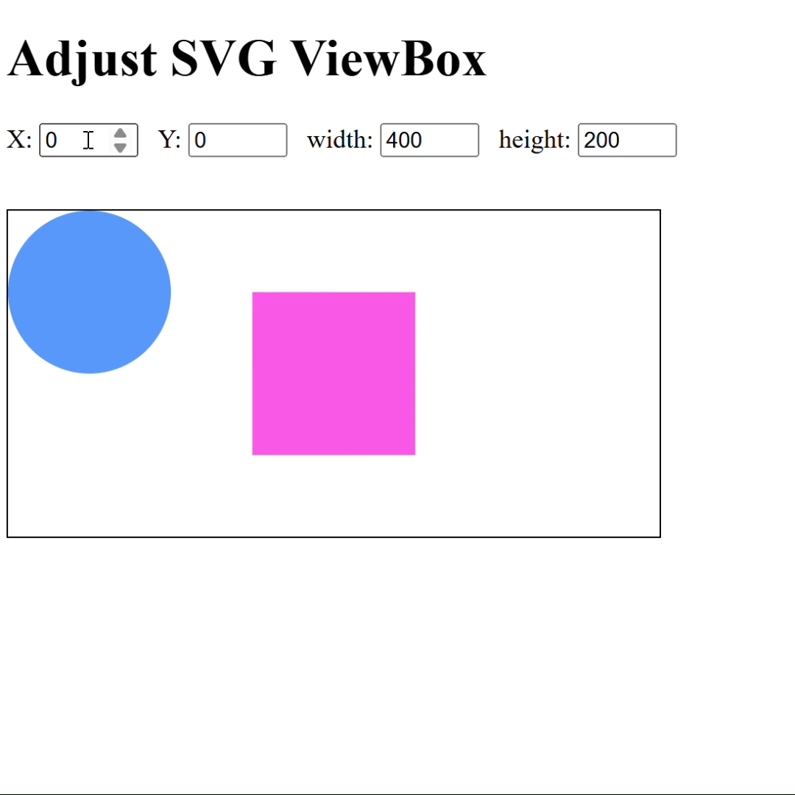
Viewbox demo
Notes:
Here’s a small demo showing how adjusting the viewbox works. In this example it can bring off-screen content onto the screen

Slide 30
What we’ve learned
Key takeaways
The <path> element is the most important in SVG, allowing you to draw anything using vector commands.
Path instructions are passed into the d attribute, which can be dense and difficult to read manually.
We can create shapes by using commands like M (Move), L (Line), and S (Smooth cubic Bézier curve).
Complex paths are typically generated by software or JavaScript, so understanding the syntax is more important than writing it from scratch.

Slide 31
THANK YOU
Rob Larsen
https://htmlcssjavascript.com
https://github.com/roblarsen
https://www.linkedin.com/in/robreact/
Code and slides:
https://github.com/roblarsen/introduction-to-svg

